Slide 1
Emerging Trends in Software Engineering

Slide 2
The Big Picture
Software intensive systems (SIS) have become the foundation of virtually every modern technology.
Software content in virtually every product and service will continue to grow—in some cases dramatically
Software must be demonstrably safe, secure, and reliable
Requirements will emerge as systems evolve
Interoperability and “networkability” will become dominant as “mash-ups” become the norm
A “smart world” demands better, more reliable software

Slide 3
A Harsh Reality
The challenges facing software engineers will get no easier as we move into the second decade of the 21st century
New process models, methods, languages, and tools will emerge,
But …
There is no silver bullet!

Slide 4
Software Intensive Systems (SIS)
Software
engineering
System
engineering
Increasing integration of software engineering and system engineering activities
Increasing emphasis on users and end-value
Increasing SIS criticality and dependability
Increasing need to manage rapid change
Increasing project/product globalization and need for interoperability
Increasing size and complexity
Increasing software “autonomy” (apps that independently evaluate their environment and choose a course of action that is appropriate)
Barry Boehm

Slide 5
Technology “Evolution”
Ray Kurzweil argues that technological evolution is similar to biological evolution, but occurs at a rate that is orders of magnitude faster.
  “ … the more capable methods resulting from one stage of evolutionary progress are used to create the next stage.” [Kurweil, R., The Singularity is Near, 2005]
What are “the more capable [process and] methods [and tools]” for software engineering?

Slide 6
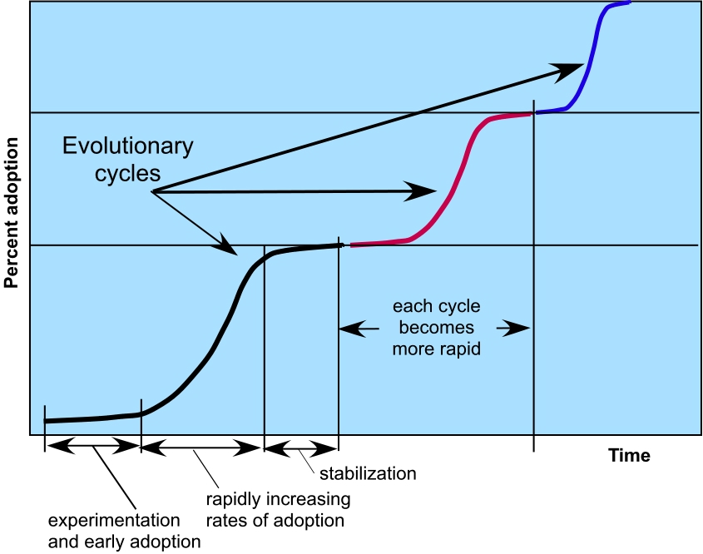
Idealized Technology Innovation Lifecycle

Slide 7
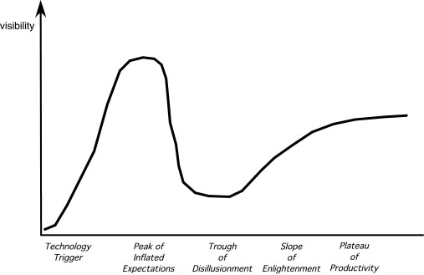
The Hype Cycle
Gartner Group, 2008

Slide 8
Software Engineering Trends
Soft Trends
  The broad characteristics of the new systems we build (and test), e.g.,
    Emergent requirements
    Autonomy of action
  The anthropological and sociological characteristics of the new generation of people who do software engineering work
Hard Trends
  The technical aspects of next generation software intensive systems
  The technical directions that software engineering process, methods, and tools will take

Slide 9
Soft Trends - I
Connectivity and collaboration (enabled by high bandwidth communication)
  software teams that do not occupy the same physical space (telecommuting and part-time employment in a local context).
Globalization leads to a diverse workforce
  in terms of language, culture, problem resolution, management philosophy, communication priorities, and person-to-person interaction
An aging population implies that many experienced software engineers and managers will be leaving the field over the coming decade
  We need viable mechanisms that capture the knowledge of these aging managers and technologists
Consumer spending in emerging economies will double to well over $9 trillion.
  Some of this spending will be applied to products and services that have a digital component that is software-based

Slide 10
Software Trends - II
People and Teams
  As systems grow in size, teams grow in number, geographical distribution, and culture
  As systems grow in complexity, team interfaces become pivotal to success
  As systems become pervasive, teams must manage emergent requirements
  As systems become more open, what is a team?

Slide 11
Managing Size & Complexity - I
In the relatively near future, systems requiring over 1 billion LOC will begin to emerge
  Consider the interfaces for a billion LOC system
    to the outside world
    to other interoperable systems
    to the Internet (or its successor), and
    to the millions of internal components that must all work together to make this computing monster operate successfully.
  How do we manage the project, the teams, the communication among software engineers?

Slide 12
Managing Size & Complexity - II
From a testing perspective:
  Is there a viable way to validate requirements?
  Is there a reasonable way to conduct technical reviews and communicate their results across hundreds of teams?
  Is there a reliable way to ensure that all of the interfaces will allow information to flow properly?
  Is there a realistic strategy for conducting tests, tracking errors, and performing debugging?
  Is there an efficient way to perform regression tests?
  How do you conduct performance tests, stress tests, and security tests when the system is huge?

Slide 13
Pervasive Computing (PvC)
Concepts such as ambient intelligence, context-aware applications, and ubiquitous computing—all focus on integrating software-based systems into an environment far broader than anything to date
Open-world software—software that is designed to adapt to a continually changing environment ‘by self-organizing its structure and self-adapting its behavior.” *
* Baresi, L., E. DiNitto, and C. Ghezzi, “Toward Open-World Software: Issues and Challenges,” IEEE Computer, October 2006.

Slide 14
Pervasive Computing (PvC)
First stage (PvC-1) [today]
  Device mobility and ad hoc networking
  Simple context awareness
  Soon: smart objects implemented in devices that have the potential to communicate with one another
Second stage (PvC-2) [over the next decade]
  Mobile user profiles that can be recognized by other objects
  Smart objects will respond to other objects based on situational characteristics
Testing issues
  Considerable environmental variation
  Complex communication issues
  Adaptive processing requirements

Slide 15
Cloud Computing
"Cloud Computing is a paradigm in which information is permanently stored in servers on the Internet and cached temporarily on clients that include desktops, entertainment centers, table computers, notebooks, wall computers, handhelds, sensors, monitors, etc.” IEEE Internet Computing
Provides software as a service (SaaS)
Device and location independence enables users to access systems regardless of their location or device
Multi-tenancy enables sharing of resources (and costs) among a large pool of users
Demands reliability, scalability, security, sustainability (Green IT)
Cloud clients
Cloud architecture
Legacy
Infrastructure

Slide 16
Emergent Requirements
As systems become more complex, requirements will emerge as everyone learns more about:
  The system’s interoperable elements
  The environment in which it is to reside, and
  The objects that interact with it.
This reality implies a number of software engineering trends.
  Software process agility—embracing change
  Judicious use of modeling methods—models will change repeatedly as more knowledge about the system is acquired
  Tools that make adaptation and change easier

Slide 17
Software Building Blocks
“merchant software”—software building blocks designed specifically for a unique application domain (e.g., VoIP devices).
The software engineering issue:
  “Component trust”
Testing Issues:
  Evaluating/Certifying a component validation suite
  Establishing trust using component testing
  Integrating using deployment testing
  Validating using system testing

Slide 18
Open Source
“Open source is a development method for software that harnesses the power of distributed peer review and transparency of process. The promise of open source is better quality, higher reliability, more flexibility, lower cost, and an end to predatory vendor lock-in.” *
The term open source when applied to computer software, implies that software engineering work products (models, source code, test suites) are open to the public and can be reviewed and extended (with controls) by anyone with interest and permission.
* OpenSource.org, 2008, available at www.opensource.org/.

Slide 19
Testing Open Source
Functionality is added regularly as the software evolves
  It must be tested asap
Refactoring occurs continually
  The behavior of the software after refactoring must be tested
Application code and test code (suites) must evolve simultaneously (“co-evolve”)
To manage testing in an open source environment, we must examine the application in three different “dimensions” *
  The change history view
  The growth history view
  The coverage/evolution view
* Zaidman, A., et al, “On how developers test open source software systems” available at citeseerx.ist.psu.edu, 2007.

Slide 20
Software Engineering Trends
Tools
Ivar Jacobson identifies four major trends:
  Reusable components—stop reinventing the wheel
  More up-front testing—test-driven development
  Platform transparency— reduce today’s programming complexity
  UML “all the way down”— model-driven development
Tools
Methods
Process

Slide 21
SE Trends—Process
Tools
Agility
Adaptability
Collaboration
Communication
ROI
Tools
Methods
Process

Slide 22
Process Trends
SPI frameworks will emphasize “strategies that focus on goal orientation and product innovation.” [Con02]
Process changes will be driven by the needs of practitioners and should start from the bottom up.
Greater emphasis will be placed on the return-on-investment of SPI activities.
Expertise in sociology and anthropology may have as much or more to do with successful SPI as other, more technical disciplines.
New modes of learning may facilitate the transition to a more effective software process.
Automated software process technology (SPT) will move away from global process management (broad-based support of the entire software process) to focus on those aspects of the software process that can best benefit from automation.

Slide 23
Collaborative Development
Today, software engineers collaborate across time zones and international boundaries, and every one of them must share information.
The challenge over the next decade is to develop methods and tools that facilitate that collaboration.
Critical success factors:
  Shared project goals
  Shared project culture
  Shared process
  Shared responsibility

Slide 24
SE Trends—Methods
Tools
In RE
In design
In languages
In testing
In SCM/SQA
Tools
Methods
Process

Slide 25
Methods: The Grand Challenge
The engineering of large, complex systems, regardless of delivery platform or application domain, the poses the “grand challenge” * for software engineers.
Key approaches:
  more effective distributed and collaborative software engineering process models
  better requirements engineering approaches
  a more robust approach to model-driven development, and
  better software tools
* Broy. M., “The Grand Challenge,” IEEE Computer, Oct., 2006.

Slide 26
Requirements Engineering
The software engineering community will likely implement three distinct sub-processes as RE is conducted:*
  improved knowledge acquisition and knowledge sharing that allows more complete understanding of application domain constraints and stakeholder needs
  greater emphasis on iteration as requirements are defined
  more effective communication and coordination tools that enable all stakeholders to collaborate effectively.
* Glinz, M., and R. Wieringa, “Stakeholders in Requirements Engineering,” IEEE Software, March–April 2007.

Slide 27
Model-Driven Development
MDD couples domain-specific modeling languages with transformation engines and generators in a way that facilitates the representation of abstraction at high levels and then transforms it into lower levels
Domain-specific modeling languages (DSMLs)
  represent “application structure, behavior and requirements within particular application domains”
  described with metamodels that “define the relationships among concepts in the domain and precisely specify the key semantics and constraints associated with these domain concepts.” *
* Schmidt, D.,”Model-Driven Engineering,” IEEE Computer, February 2006.

Slide 28
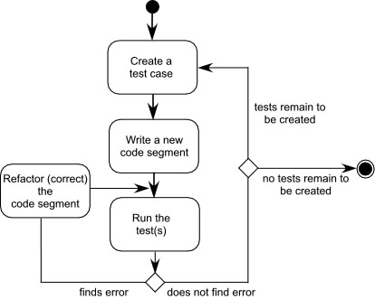
Test-Driven Development
In test-driven development (TDD), requirements for a software component serve as the basis for the creation of a series of test cases that exercise the interface and attempt to find errors in the data structures and functionality delivered by the component.
TDD is not really a new technology but rather a trend that emphasizes the design of test cases before the creation of source code. Continues to emphasize the importance of software architecture.

Slide 29
Service-Oriented Development
Strives to create models that can be understood by individuals with diverse levels of business and technical understanding.
The service-oriented modeling paradigm advocates taking a holistic view of the analysis, design, and architecture of all 'Software Entities' in an organization.
Service-oriented modeling encourages viewing software entities as 'assets' (service-oriented assets), and refers to these assets collectively as 'services'.
Atomic service
Composite service
Service Cluster

Slide 30
Aspect-Oriented Development
Concerns—customer required properties or areas of technical interest
Cross cutting concerns—concerns cut across multiple system functions, features, and information
AOD provides a process and methodological approach for defining, specifying, designing, and constructing aspects— mechanisms beyond subroutines and inheritance for localizing the expression of a crosscutting concern
Cross-Cutting Concern
Requirements

Slide 31
SE Trends—Tools
Tools
Project mgmt.
Modeling
Programming
Testing
Maintenance
SCM
SEEs
Tools
Methods
Process

Slide 32
Tools Trends—RE and Modeling
Requirements engineering tools will combine voice recognition input with “text mining” to extract requirements from informal information sources
As pervasive computing becomes commonplace, design modeling tools must allow the designer to consider the architecture and behavior of the software and the physical properties of the devices on which the software resides

Slide 33
Tools Trends—Testing
As test-driven development approaches gain momentum, tools for selecting test cases based on requirements and/or models must be developed. In addition, the software engineering community needs better tools for:
  Launching selected tests in multiple device environments
  Assessing the test outcome (sometimes called a “test oracle”)
  Evaluating the impact of failures and determining the root cause of the failure
  Determining whether the testing regime is sufficient

Slide 34
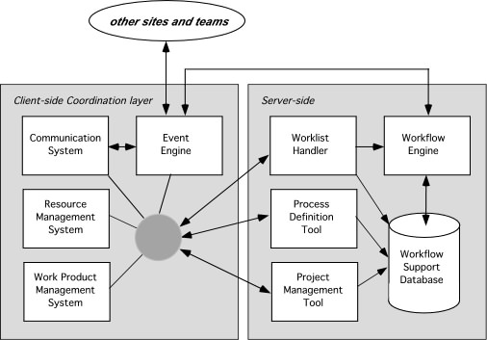
Tools Trends—SEE

Slide 35
The Road Ahead
“We're driving faster and faster into the future, trying to steer by using only the rear-view mirror.” Marshall McLuhan
“Artificial intelligence is about at the same place the personal computer industry was in 1978.” BBC News
Prediction by consensus: similar to www.hubdub.com
“…the best way to predict the future is to invent it.” Alan Kay

